Slide 1
Conceptual Model
Reza Giga Isnanda, S.T., M.Sc.
Senin, 29 April 2019

Slide 2
Last Week
Requirement Analysis
From Data to Requirement
MoSCoW Method

Slide 3
Today
Conceptual Model
Conceptual Model, Mental Model, System Image

Slide 4
Today Learning Outcome
Mahasiswa memahami hubungan conceptual model, mental model, dan system image

Slide 5
Lesson So Far…
Sejauh ini, ilmu yang dipelajari:
User experience
Requirement gathering
Persona & scenario
Requirement analysis

Slide 6
Lesson So Far…
What we
have learnt
Design
Notes:
Ilmu itu baru sebagian kecil dari ilmu HCI
Sebagian besar dari ilmu HCI adalah mengenai design
bagaimana teori dan requirement gathering itu digunakan akhirnya mendesign produk dengan bentuk interaksi terbaik

Slide 7
Conceptual Model
And
Mental Model

Slide 8
I’ll show you some pictures
What do you think?

Slide 9


Slide 10


Slide 11


Slide 12
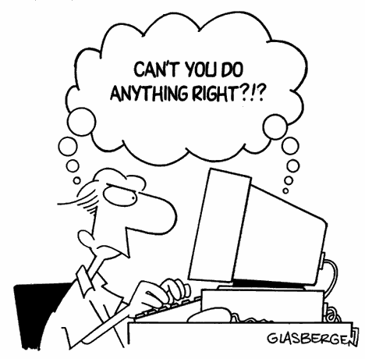

Slide 13
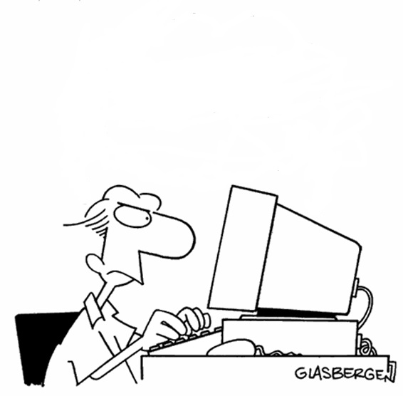
#
?
?
!
*
What is this?
How can I use it?
How does it work?
!
!
?
!
?
#
*
!
Notes:
Tapi penting untuk mengetahui apa yang dipikirkan user saat melihat sistem
Karena sebelum user membentuk goal dan intention, user pasti memikirkan/membayangkan sesuatu saat melihat sistem
Saat user melihat sistem, ia akan memikirkan:
Bagaimana kira-kira sistem bekerja
Apa saja interaksi yang bisa dilakukan dengan sistem
Seberapa jauh sistem bisa membantu mencapai goal

Slide 14

Mental Model
Notes:
Goal dan intention user terbentuk berdasarkan apa yang user pikirkan tentang sistem
Konsekuensinya:
Jika pikiran user benar, user cepat mahir berinteraksi
Jika pikiran user salah, user lambat atau gagal berinteraksi

Slide 15
Conceptual Model & Mental Model
Definisi mental model
“ Model dalam pikiran seseorang yang merepresentasikan pemahaman mereka tentang bagaimana sebuah benda bekerja/berfungsi ”
Mental model = asumsi user tentang cara kerja sistem
Mental model dibentuk dari:
Interaksi langsung antara user dengan sistem
Pengalaman user berinteraksi dengan sistem serupa
Notes:
User tidak perlu tahu dengan pasti cara kerja sistem
Yang penting, mental model mendekati bagaimana cara kerja sistem sebenarnya

Slide 16
Conceptual Model & Mental Model
Donald Norman berkata:
“ Tidak masalah jika anda salah di percobaan pertama.
Tidak masalah jika anda harus membaca buku atau minta diajarkan seseorang.
Tapi akan jadi masalah jika anda harus melakukan hal yang sama untuk kedua kalinya “

Slide 17
How to help User?
Make the interaction
Easy and Intuitive

Slide 18
How to design such interaction?
Understand user’s mental model

Slide 19



?
Notes:
Agar interaksi mudah dan intuitif, tugas designer adalah:
Menebak mental model user

Slide 20

Notes:
Mengarahkan mental model user ke model yang diinginkan

Slide 21
Conceptual Model
Notes:
Designer perlu membuat conceptual model
Conceptual model = model konsep buatan designer mengenai tampilan dan operasi sistem
Conceptual model = cara bagaimana designer merepresentasikan fungsi sistem ke user

Slide 22
Conceptual Model & Mental Model
Conceptual model
The mental representation of the design/system
Model made by designer about the top level of the system’s interface and operation

Slide 24

Notes:
Gambar ini kurang tepat karena designer sulit berinteraksi langsung dengan user

Slide 25
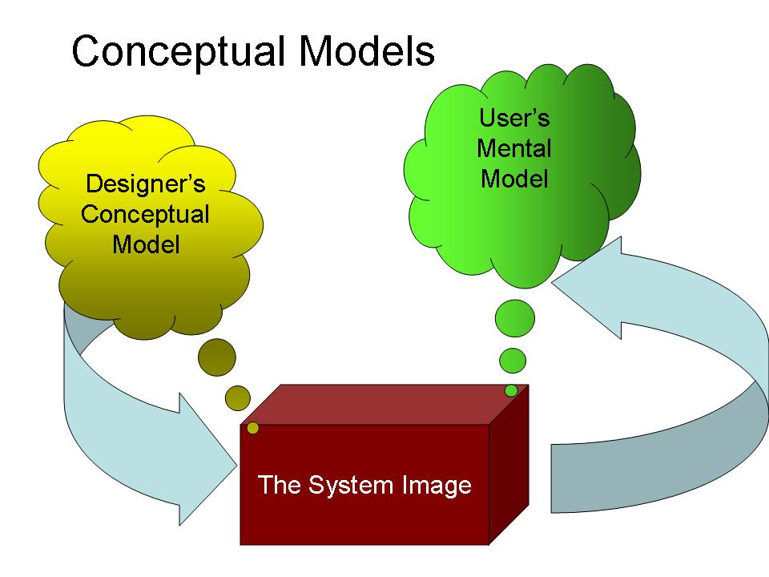
Notes:
Ini gambar yang tepat.
Conceptual model: model milik designer mengenai konsep kerja sistem
Mental model: model asumsi user mengenai cara kerja sistem
System image: interface sistem yang diciptakan designer dan yang sesungguhnya dilihat dan digunakan oleh user. System image menyangkut produk beserta manual, help, dan lain-lain
Designer berinteraksi dengan user melalui system image.
For people to use a product successfully, they must have the same mental model (the user's model) as that of the designer (the designer's model).
But the designer only talks to the user via the product itself, so the entire communication must take place through the "system image": the information conveyed by the physical product itself.
So, basically, all of the other 6 fundamental principles of design feed into the conceptual model that the user creates in their mind of how this thing is supposed to work.
If all of these principles are done well (e.g. naturalistic mapping, discoverable affordances, etc), then the conceptual model the user forms will be very similar to the one the designers had in mind and they will use the product correctly and effectively.
However, when there is a disconnect between the conceptual model of the designer and that of the user, that is when trouble can occur
The design projects all the information needed to create a good conceptual model of the system, leading to understanding and a feeling of control.
The conceptual model enhances both discoverability and evaluation of results.

Slide 26
Summary
In this session, I learned that:

Slide 27
Reading Assignment
Knowing Design From Don Norman — Discoverability
https://andyyanmonashmit.wordpress.com/2017/10/21/knowing-design-from-don-norman-discoverability/
Human Centered Design & The 6 Fundamental Principles of Interaction Between Products and Users
http://againstdesign.com/human-centered-design-the-6-fundamental-principles-of-interaction-between-products-and-users/

Slide 28
Reading Assignment
7 fundamentals of design – and how they apply to online spaces
https://socialinsilico.wordpress.com/2015/01/27/7-fundamentals-of-design-and-how-they-apply-to-online-spaces/
Frustrating Doors: The Principles of Human Centred Design
https://www.internetrix.com.au/blog/frustrating-doors-and-the-principles-of-human-centred-design/
Knowing Design From Don Norman — Discoverability
https://andyyanmonashmit.wordpress.com/2017/10/21/knowing-design-from-don-norman-discoverability/

Slide 29
Next Week
Norman’s Seven Fundamental Principles of Design
Affordance
Signifier
Constraint
Feedback
Mapping
Discoverability

